Slide 1
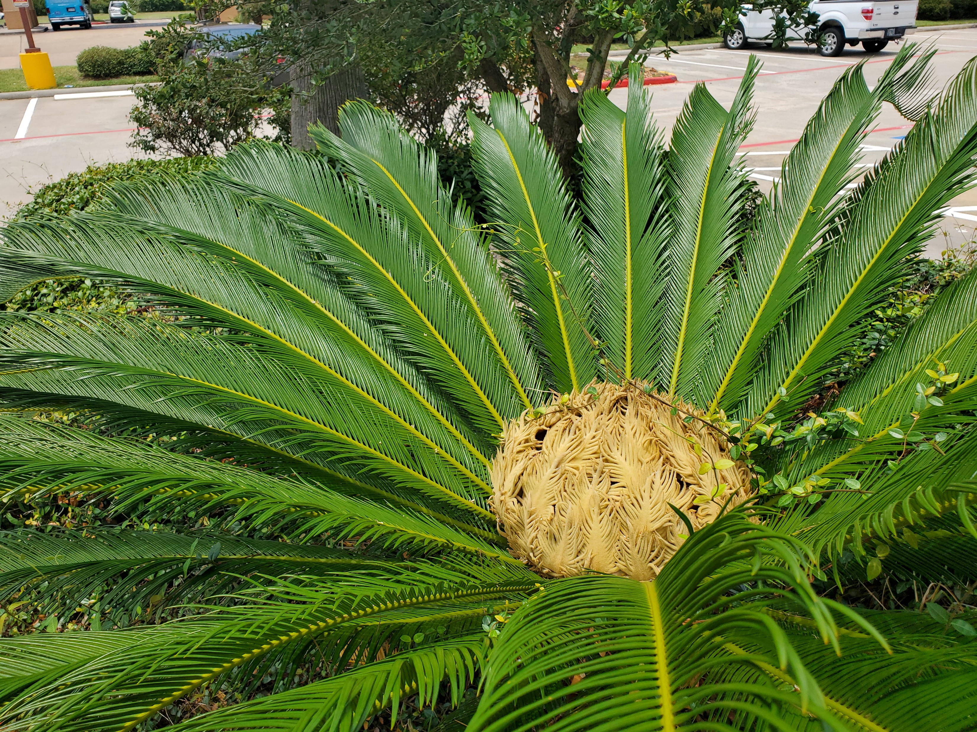

Leaf Morphology: Practice Describing Leaves!
Cycas revoluta, “Sago Palm”
Not a palm, but a cycad. Cycads are acrogymnosperms, palms are angiosperms. This one is a female: naked ovules will develop on the modified leaves in the center later in the year. Is the leaf simple or compound, what is its overall shape?

Slide 2
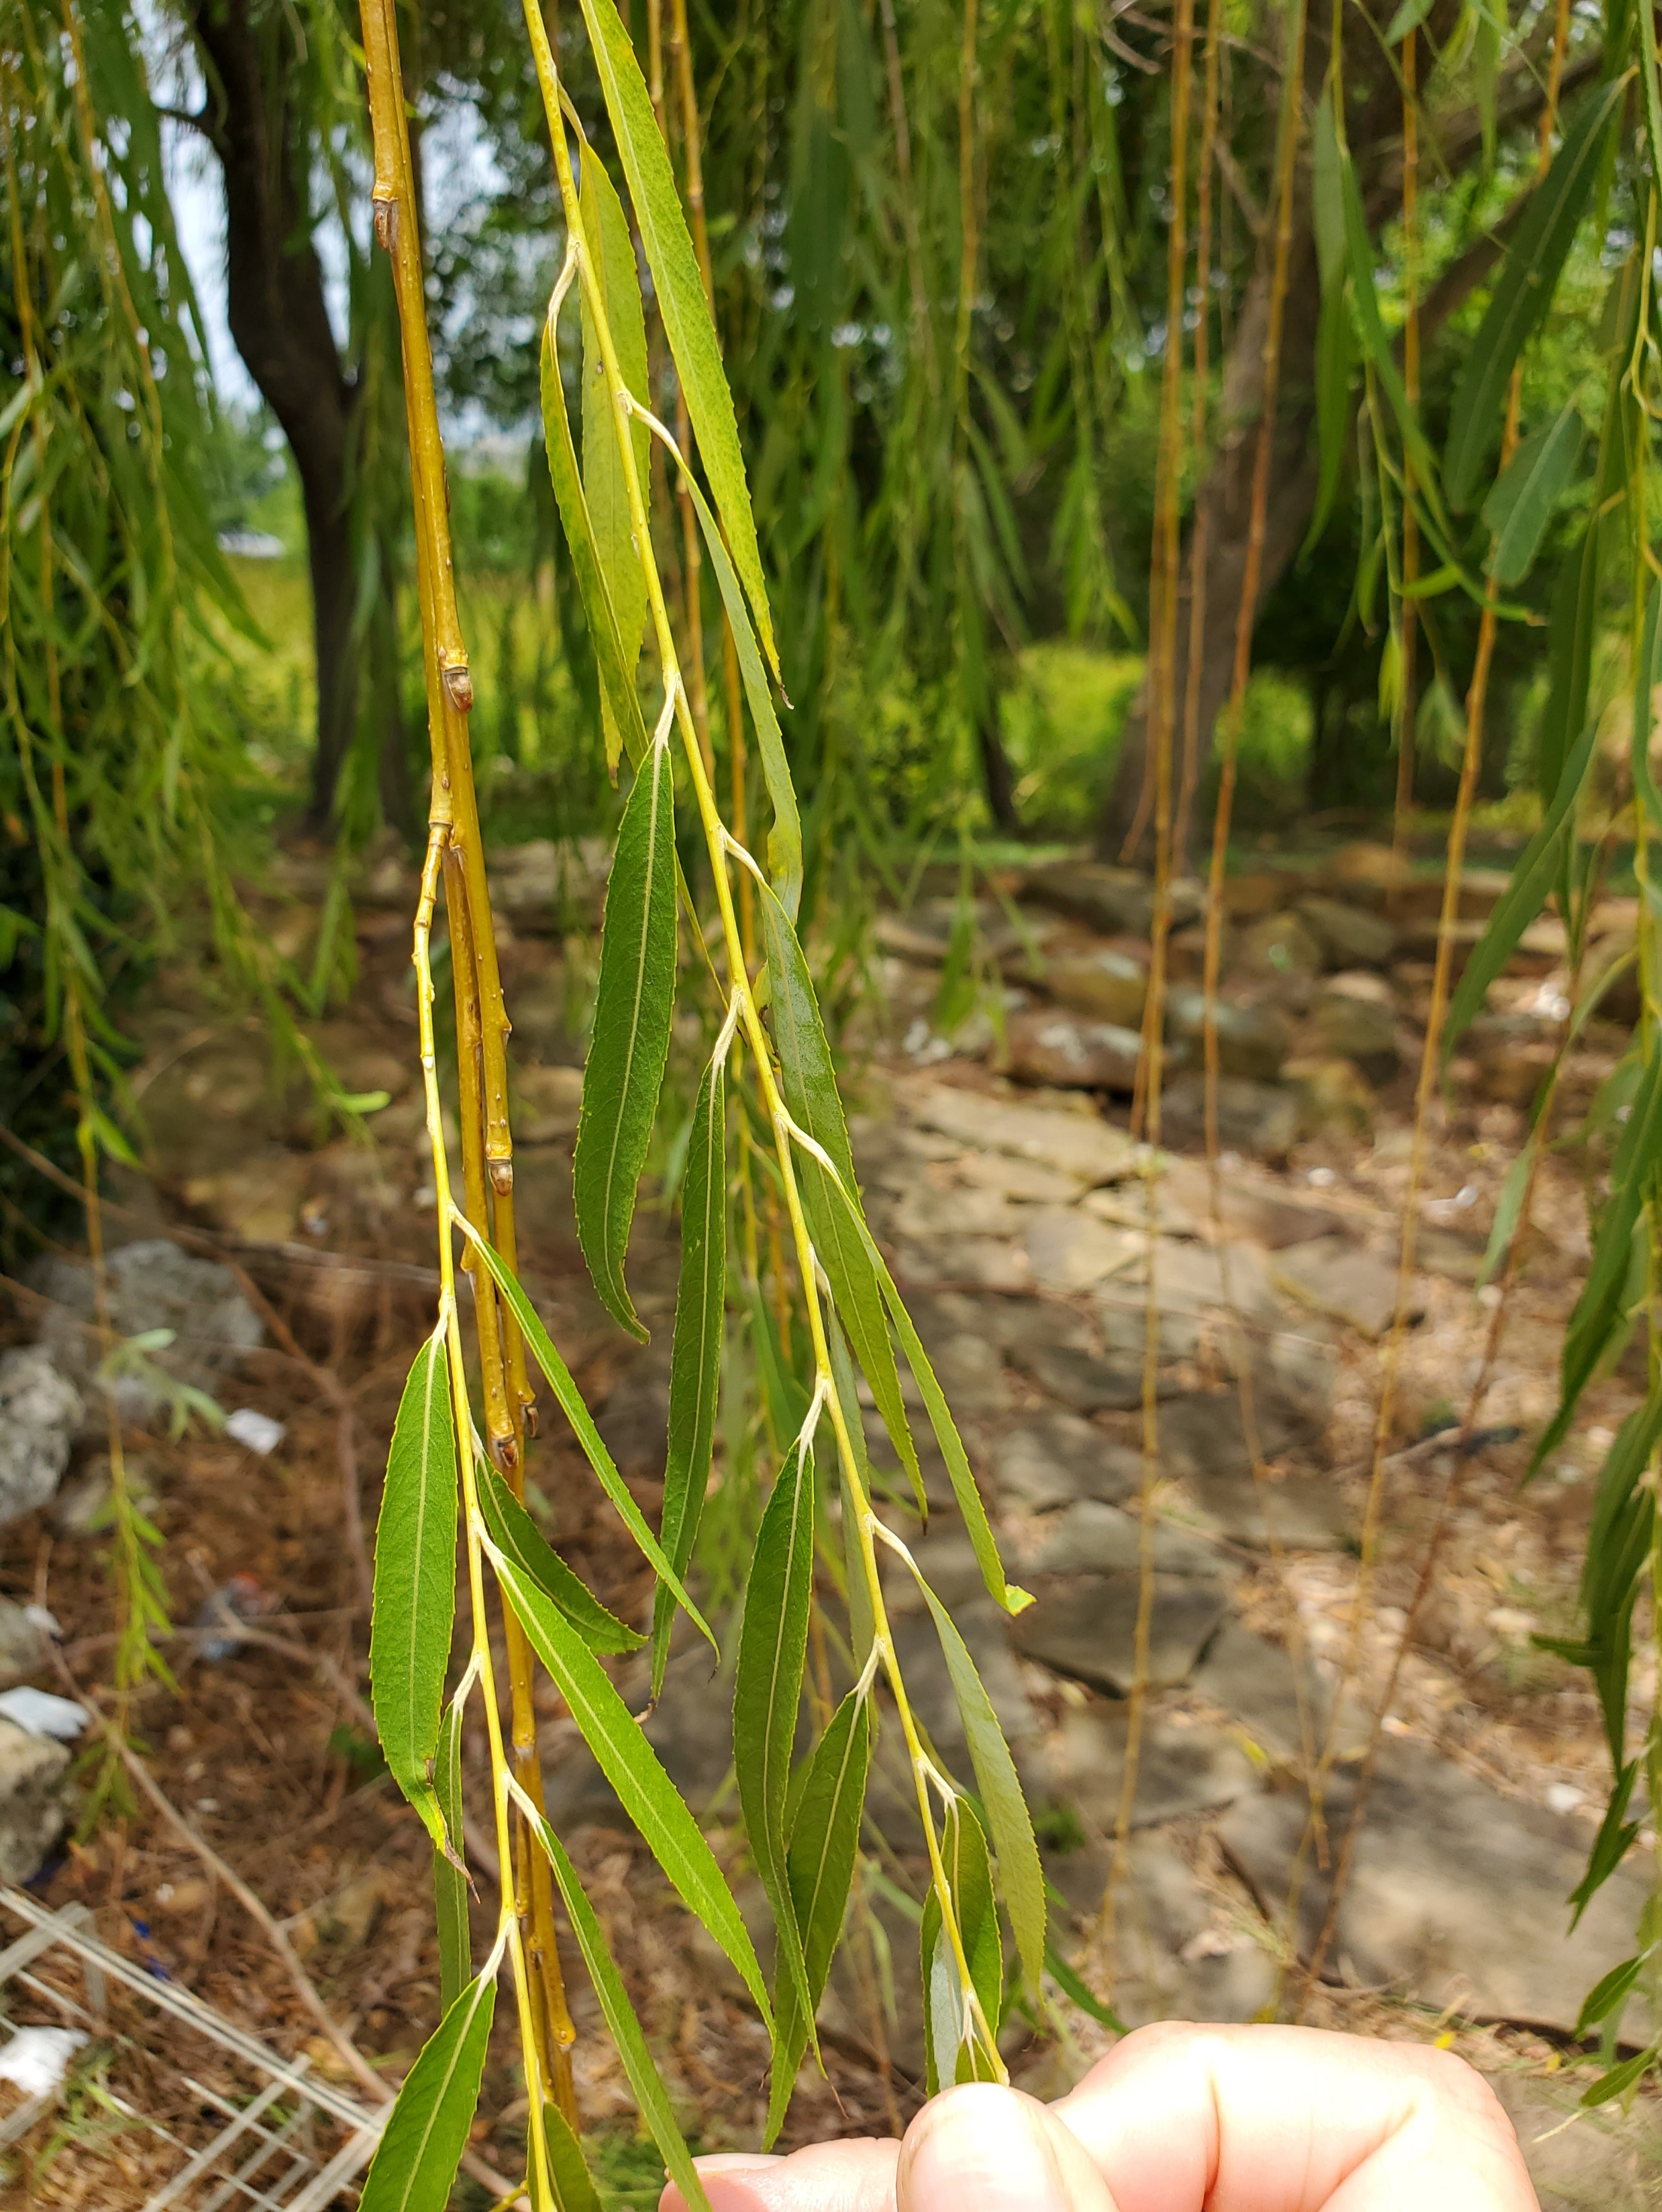
Leaf complexity: simple, compound? If compound, then trifoliolate, palmate, or pinnately so?
Leaf arrangement: opposite, alternate or whorled?
Leaf shape: ovate, obovate, elliptic or oblong?
Leaf apex: acute or obtuse? If acute, is it acuminate?
Leaf base: acute, cordate or obtuse?
Leaf Margin: entire, serrate, lobed, dentate, doubly serrate, crenate, erose?
Salix: a willow– describe the leaf for me…

Slide 3
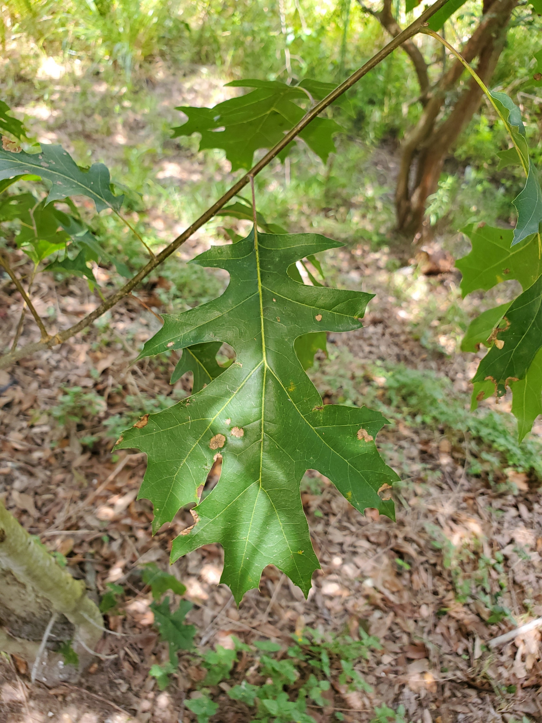
Oak, Quercus sp.
Leaf complexity: simple, compound? If compound, then trifoliolate, palmate, or pinnately so?
Leaf arrangement: opposite, alternate or whorled?
Leaf shape: ovate, obovate, elliptic or oblong?
Leaf apex: acute or obtuse? If acute, is it acuminate?
Leaf base: acute, cordate or obtuse?
Leaf Margin: entire, serrate, lobed, dentate, doubly serrate, crenate, erose?

Slide 4
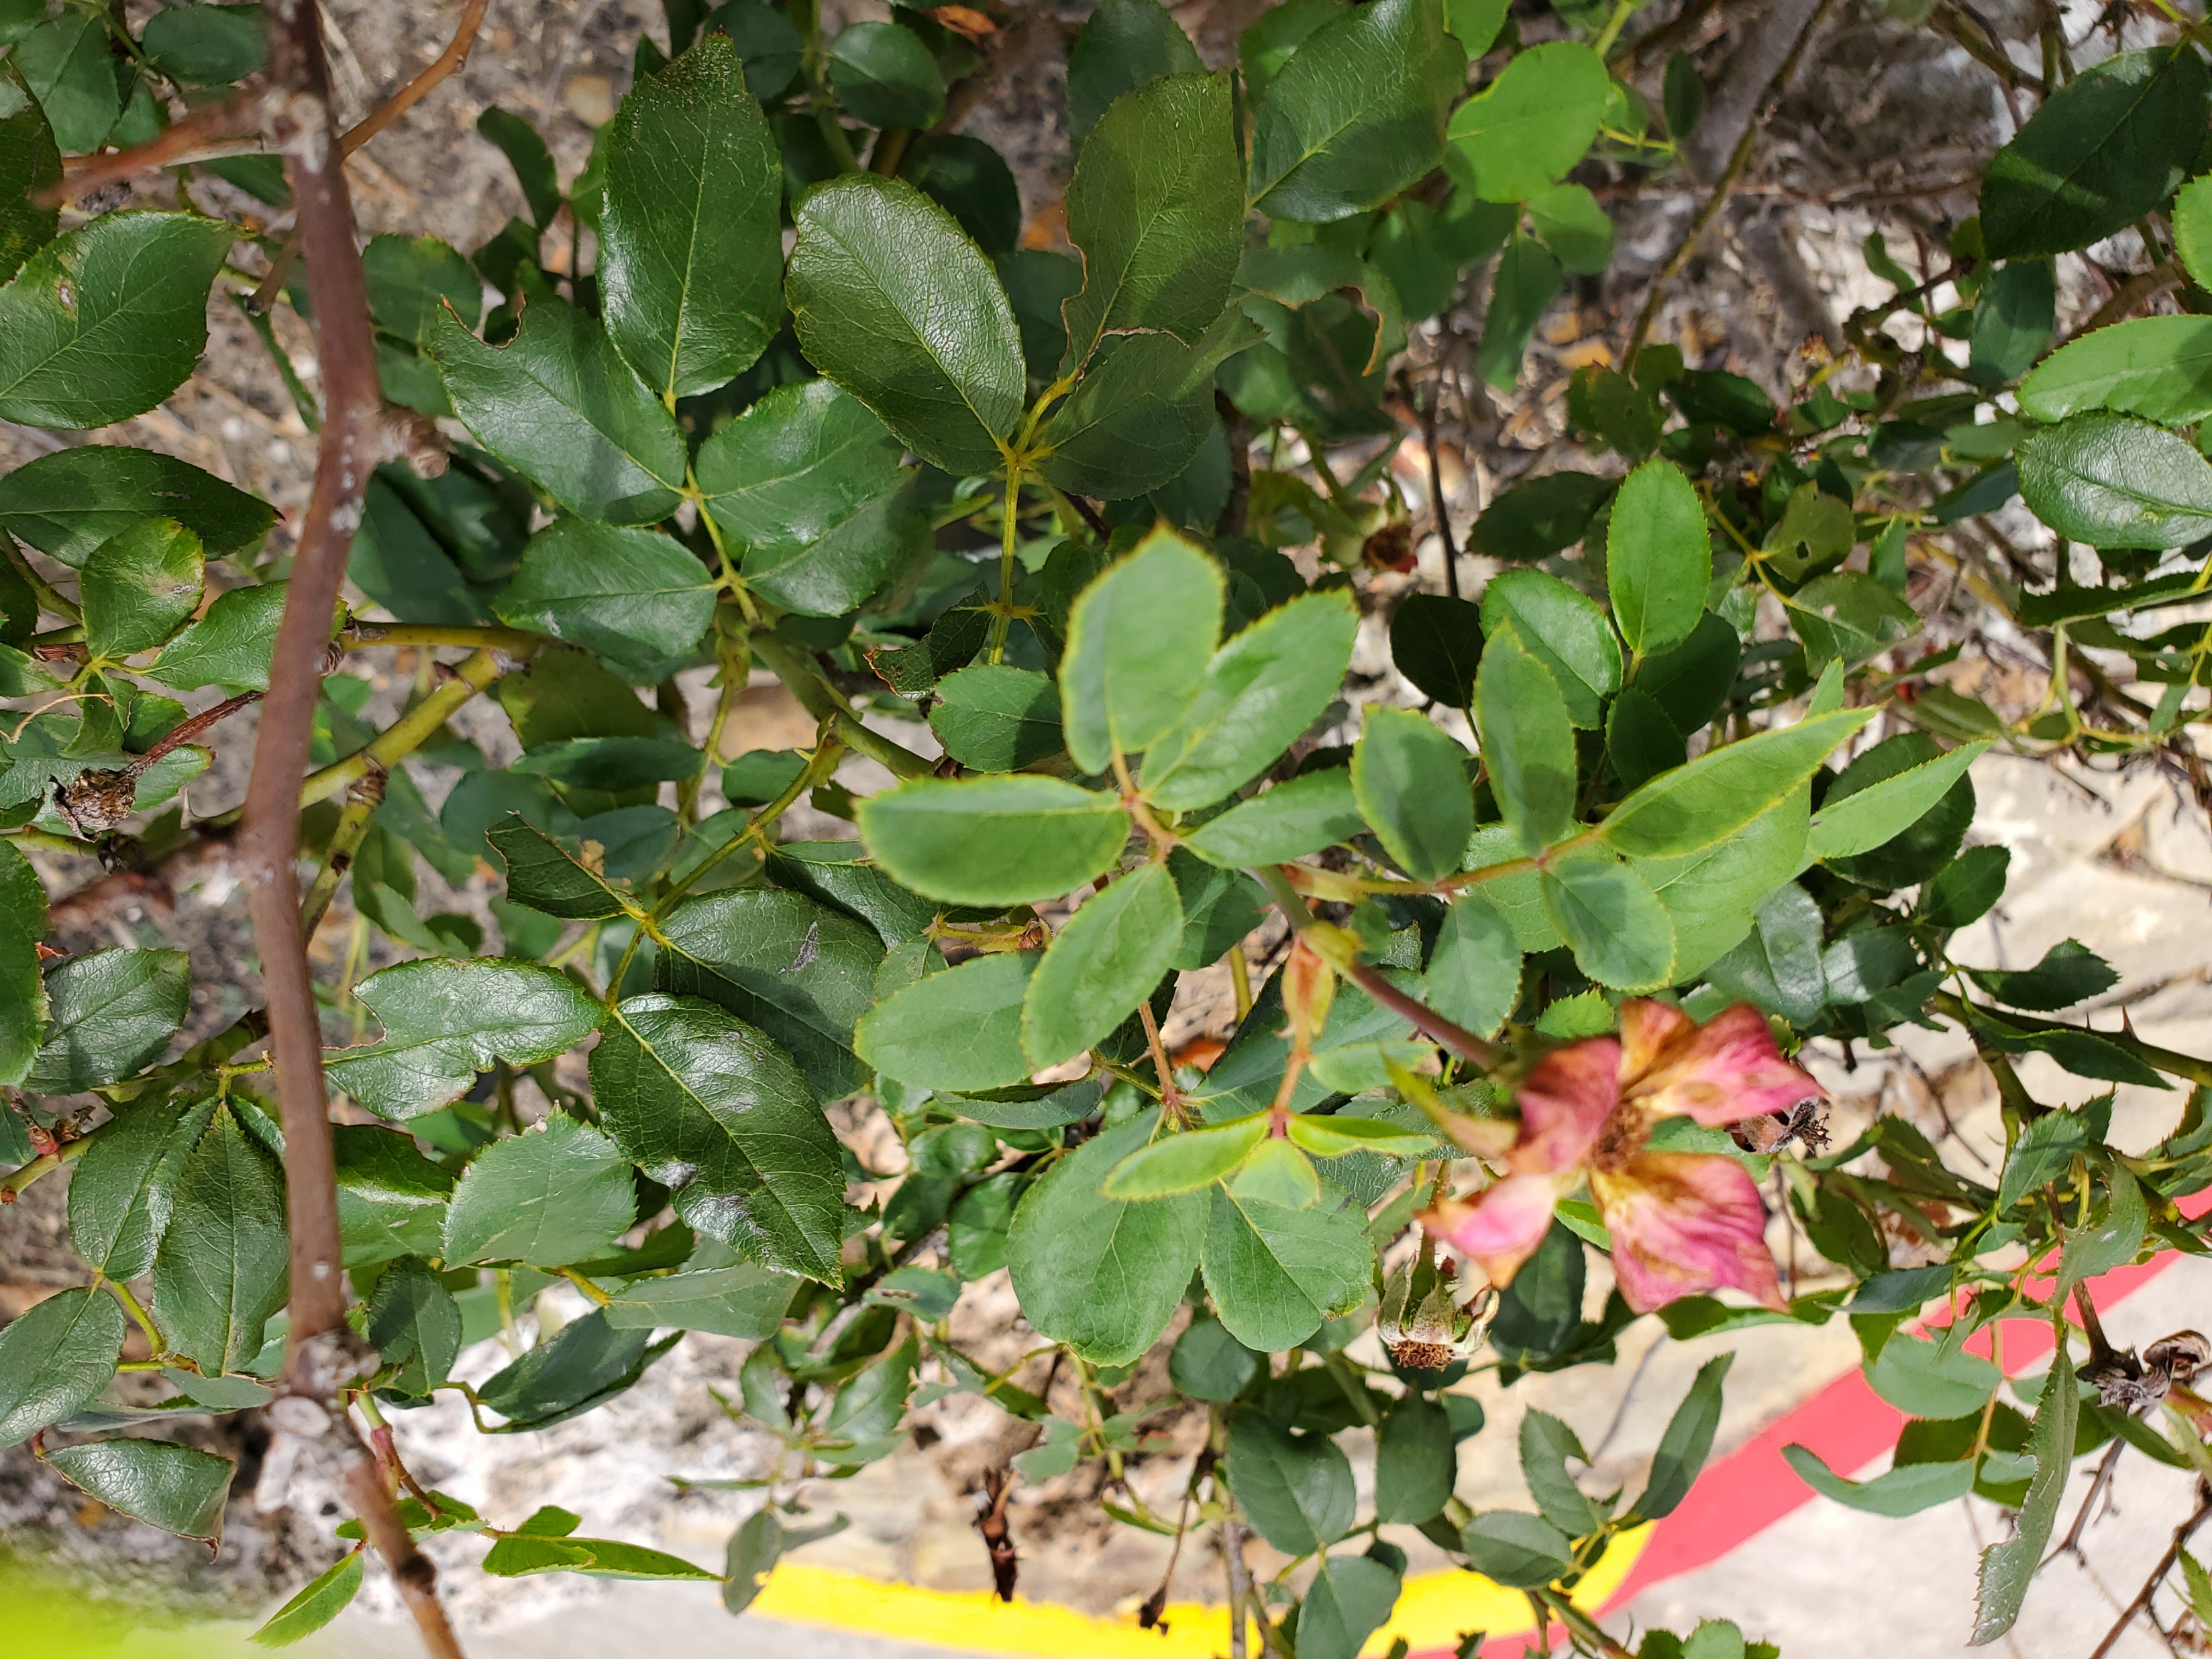
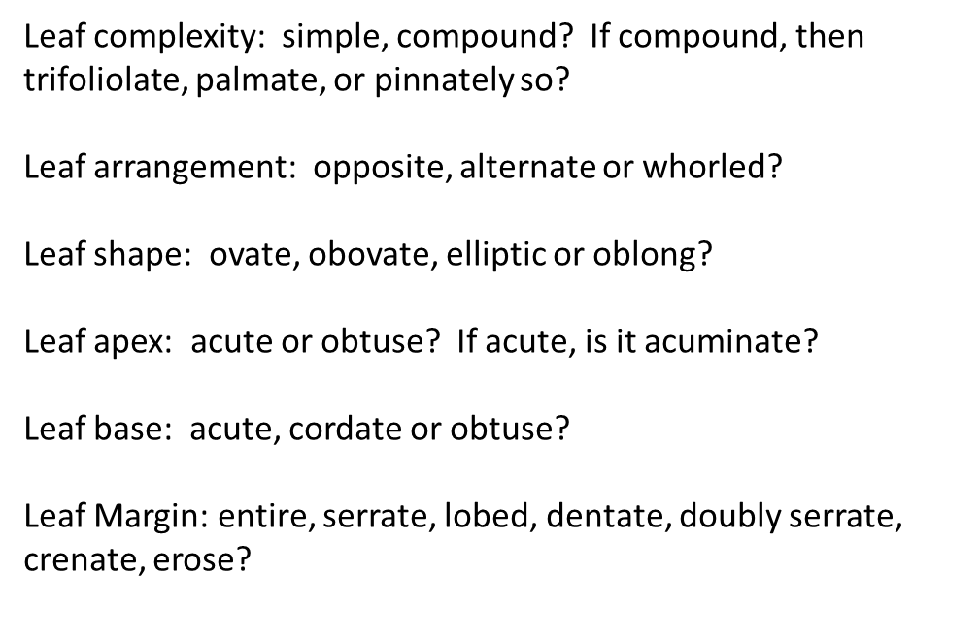
Rosa sp., rose bush…
Can you see stipules on these leaves?

Slide 5
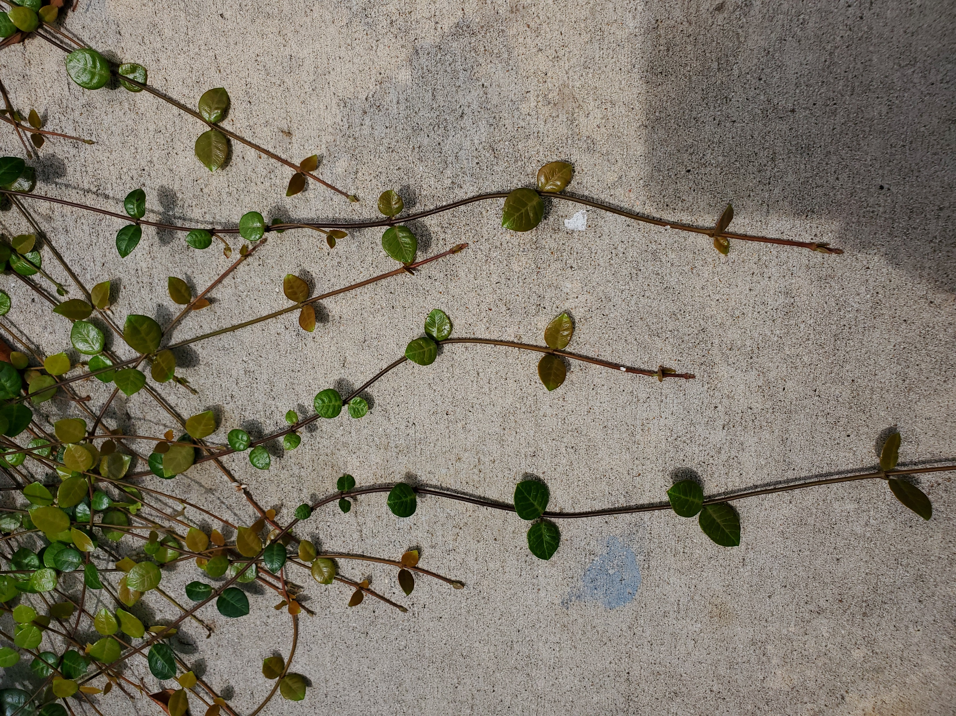
Just a cultivated plant in the parking lot in the La Quinta in Tomball, TX.

Slide 6
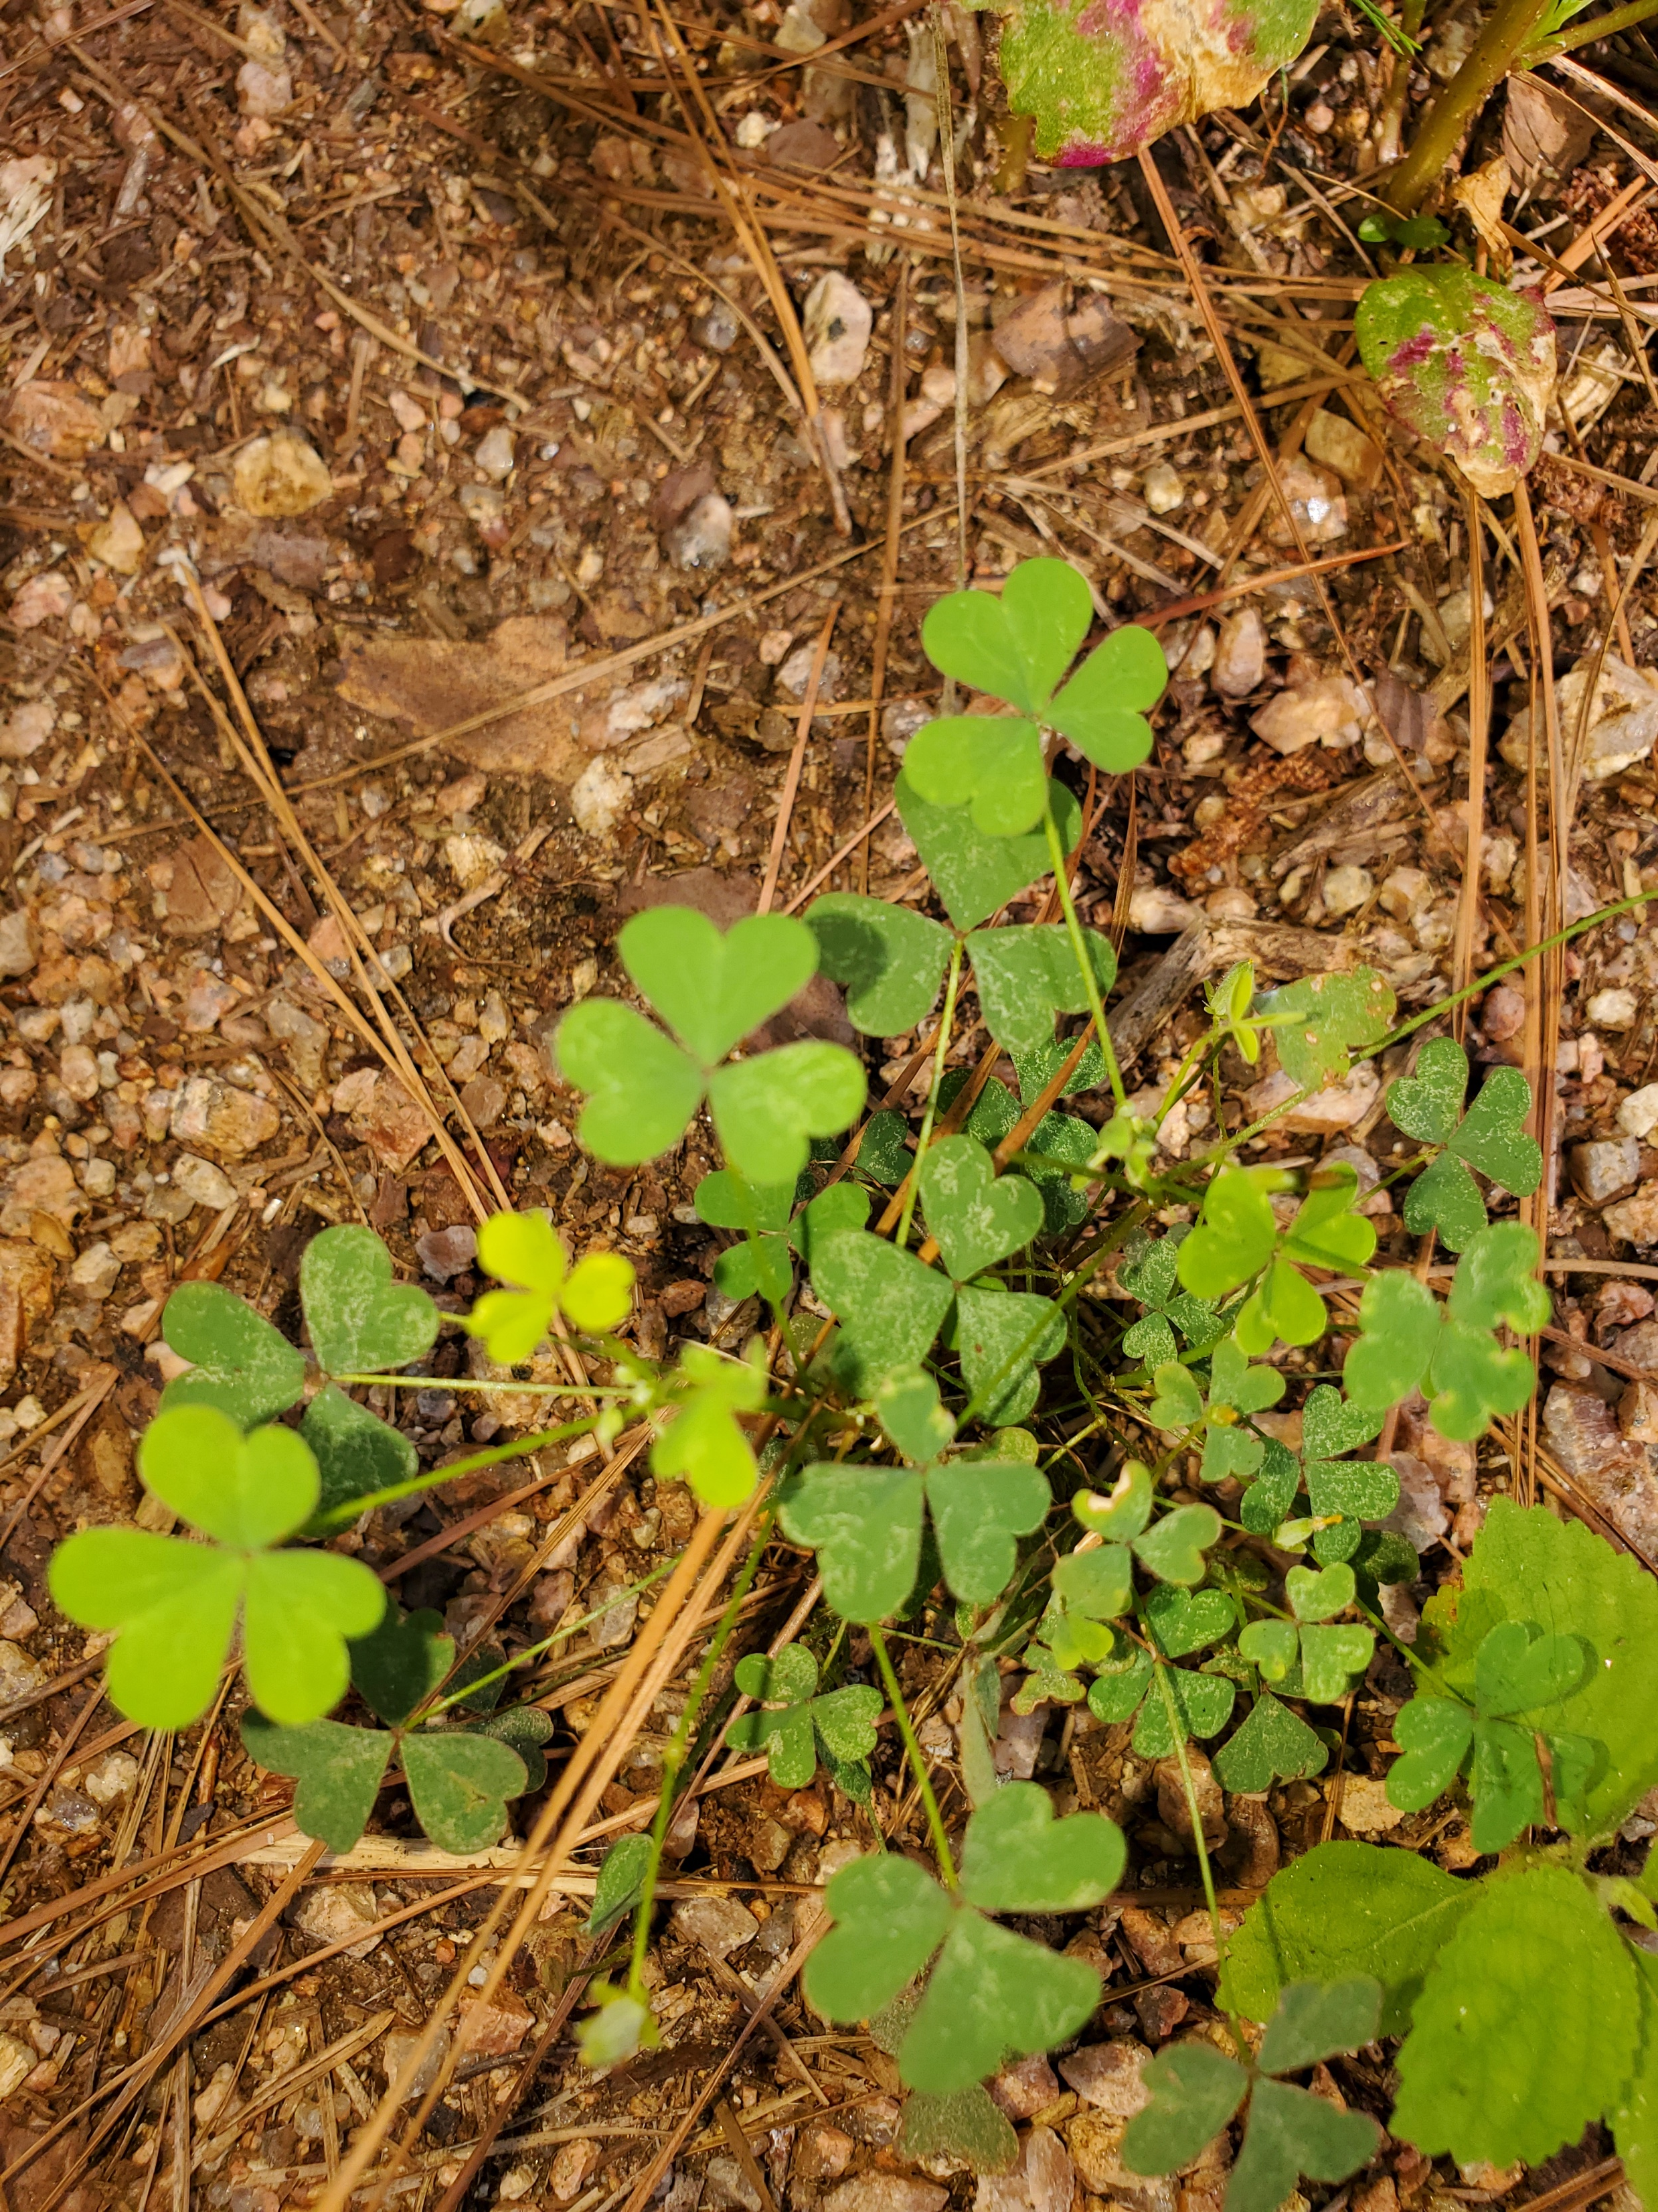
Oxalis corniculata, creeping woodsorrel…

Slide 7
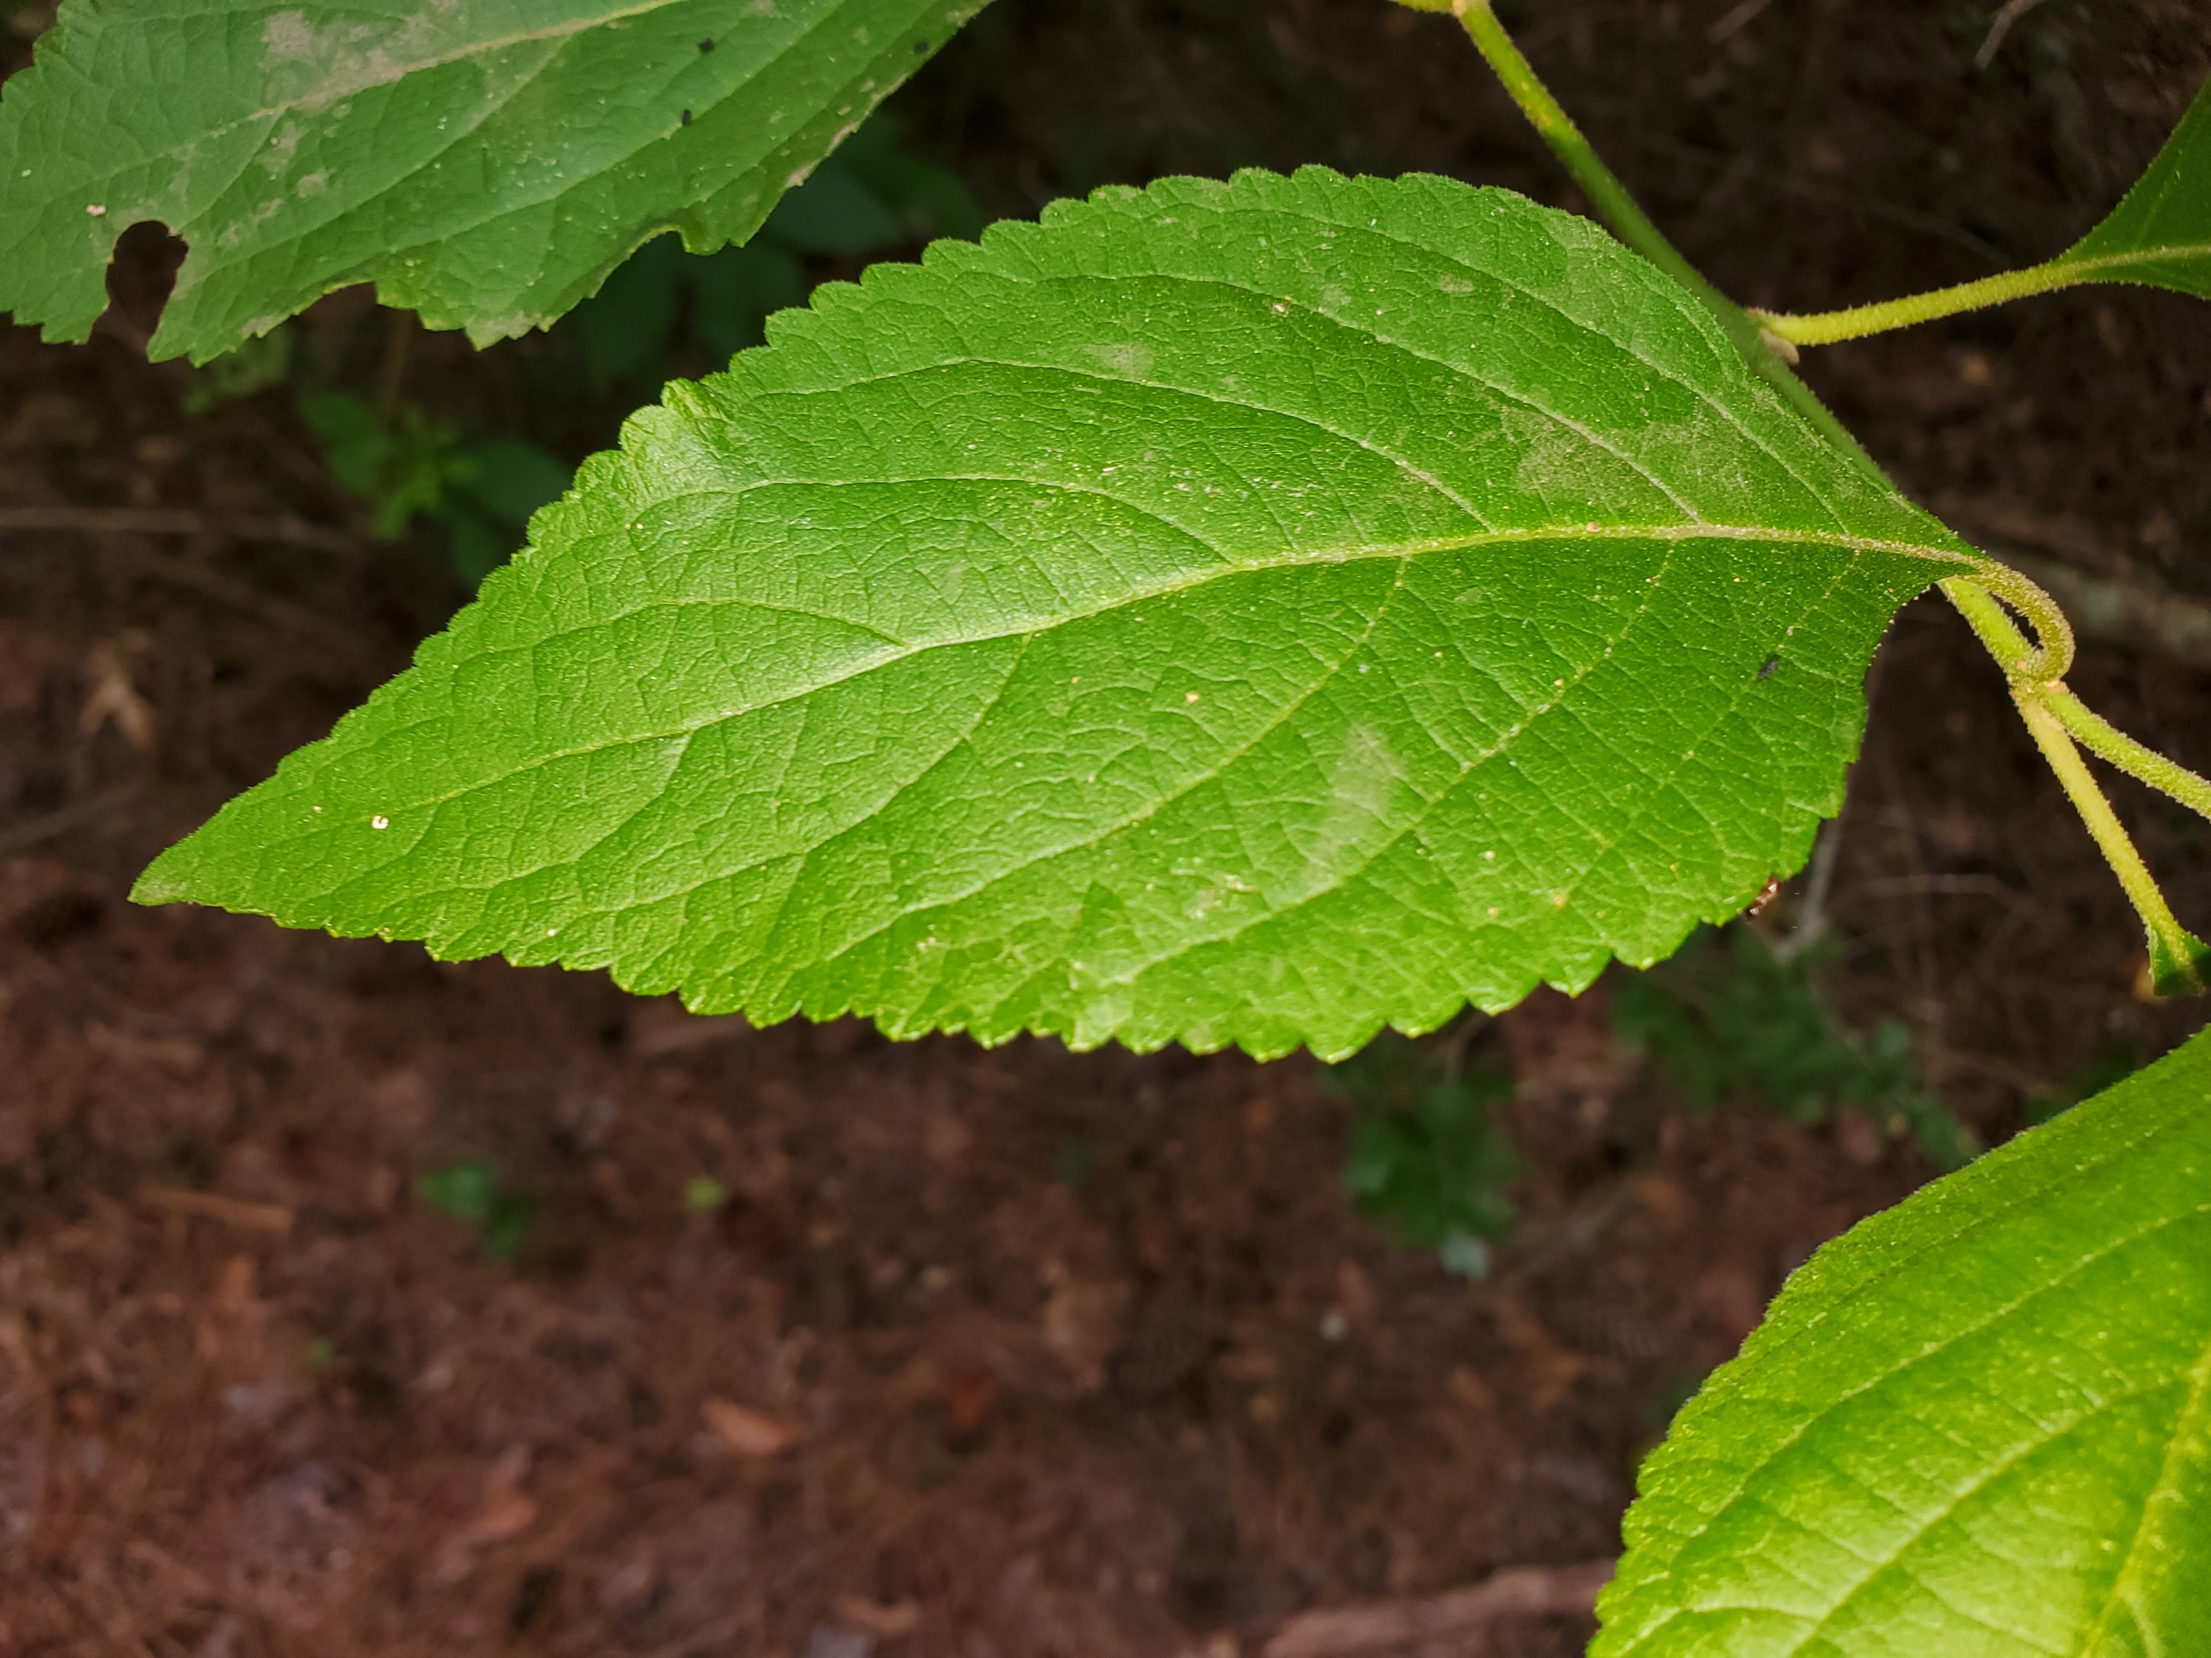
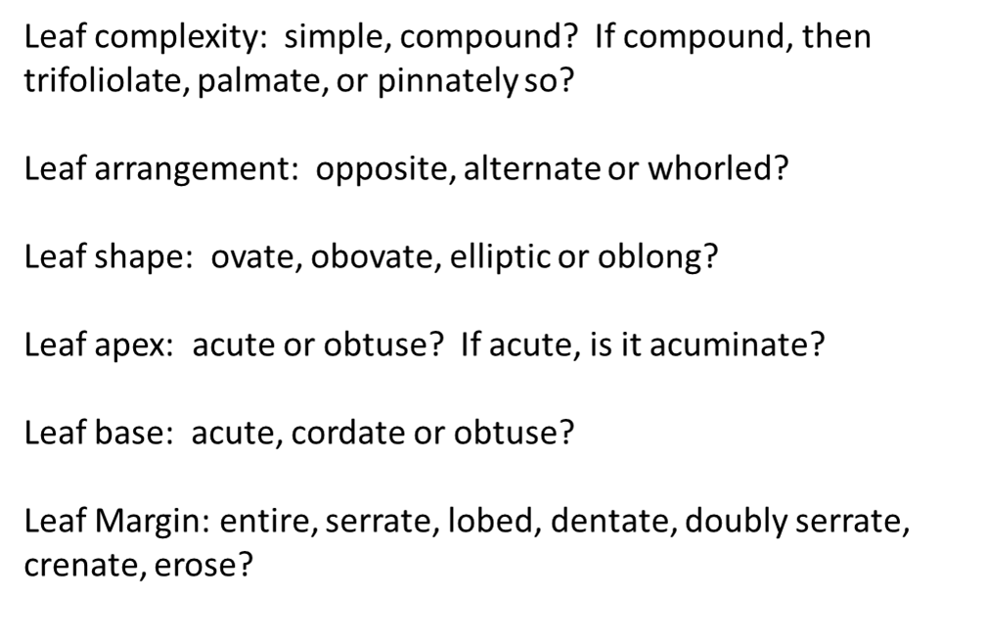
Unknown plant at Burroughs Park in Tomball, TX…

Slide 8
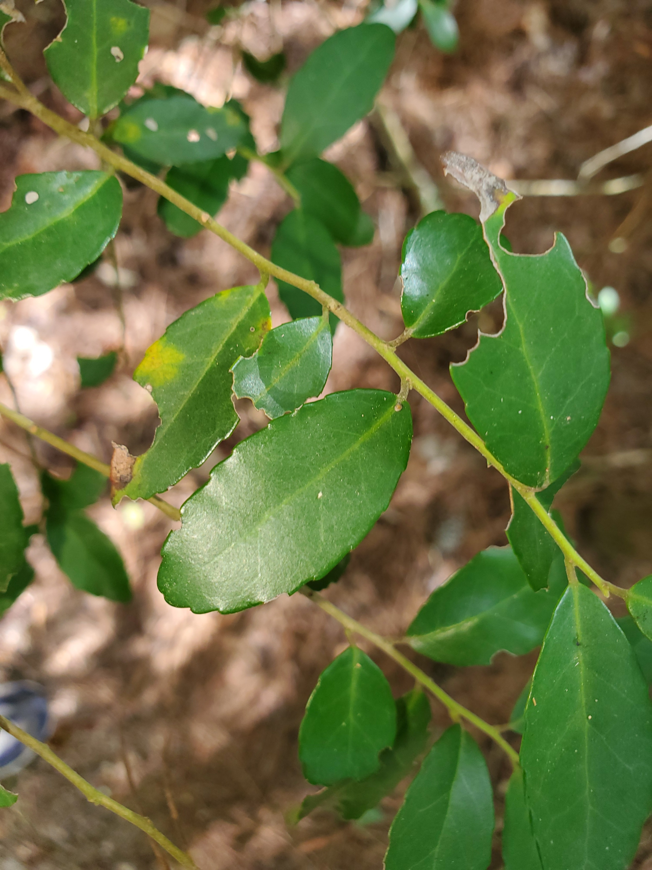
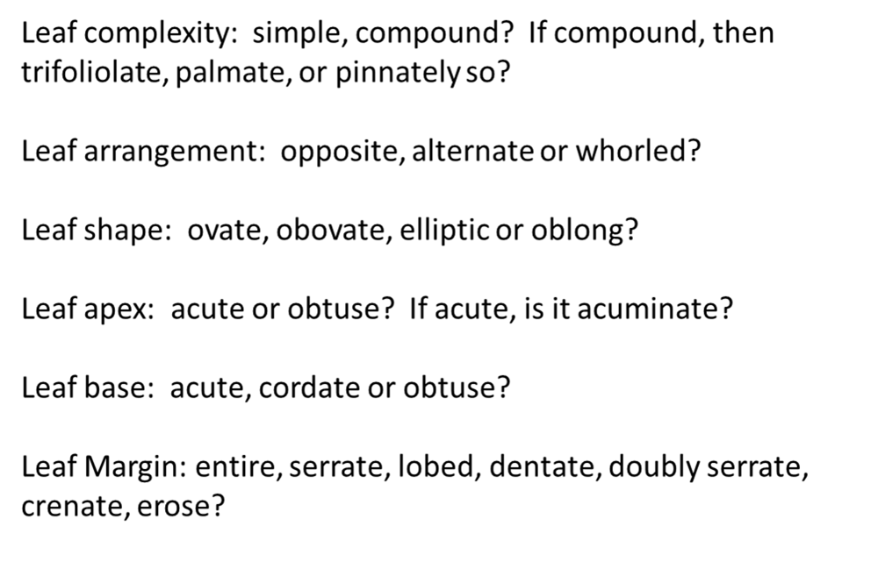

Slide 9
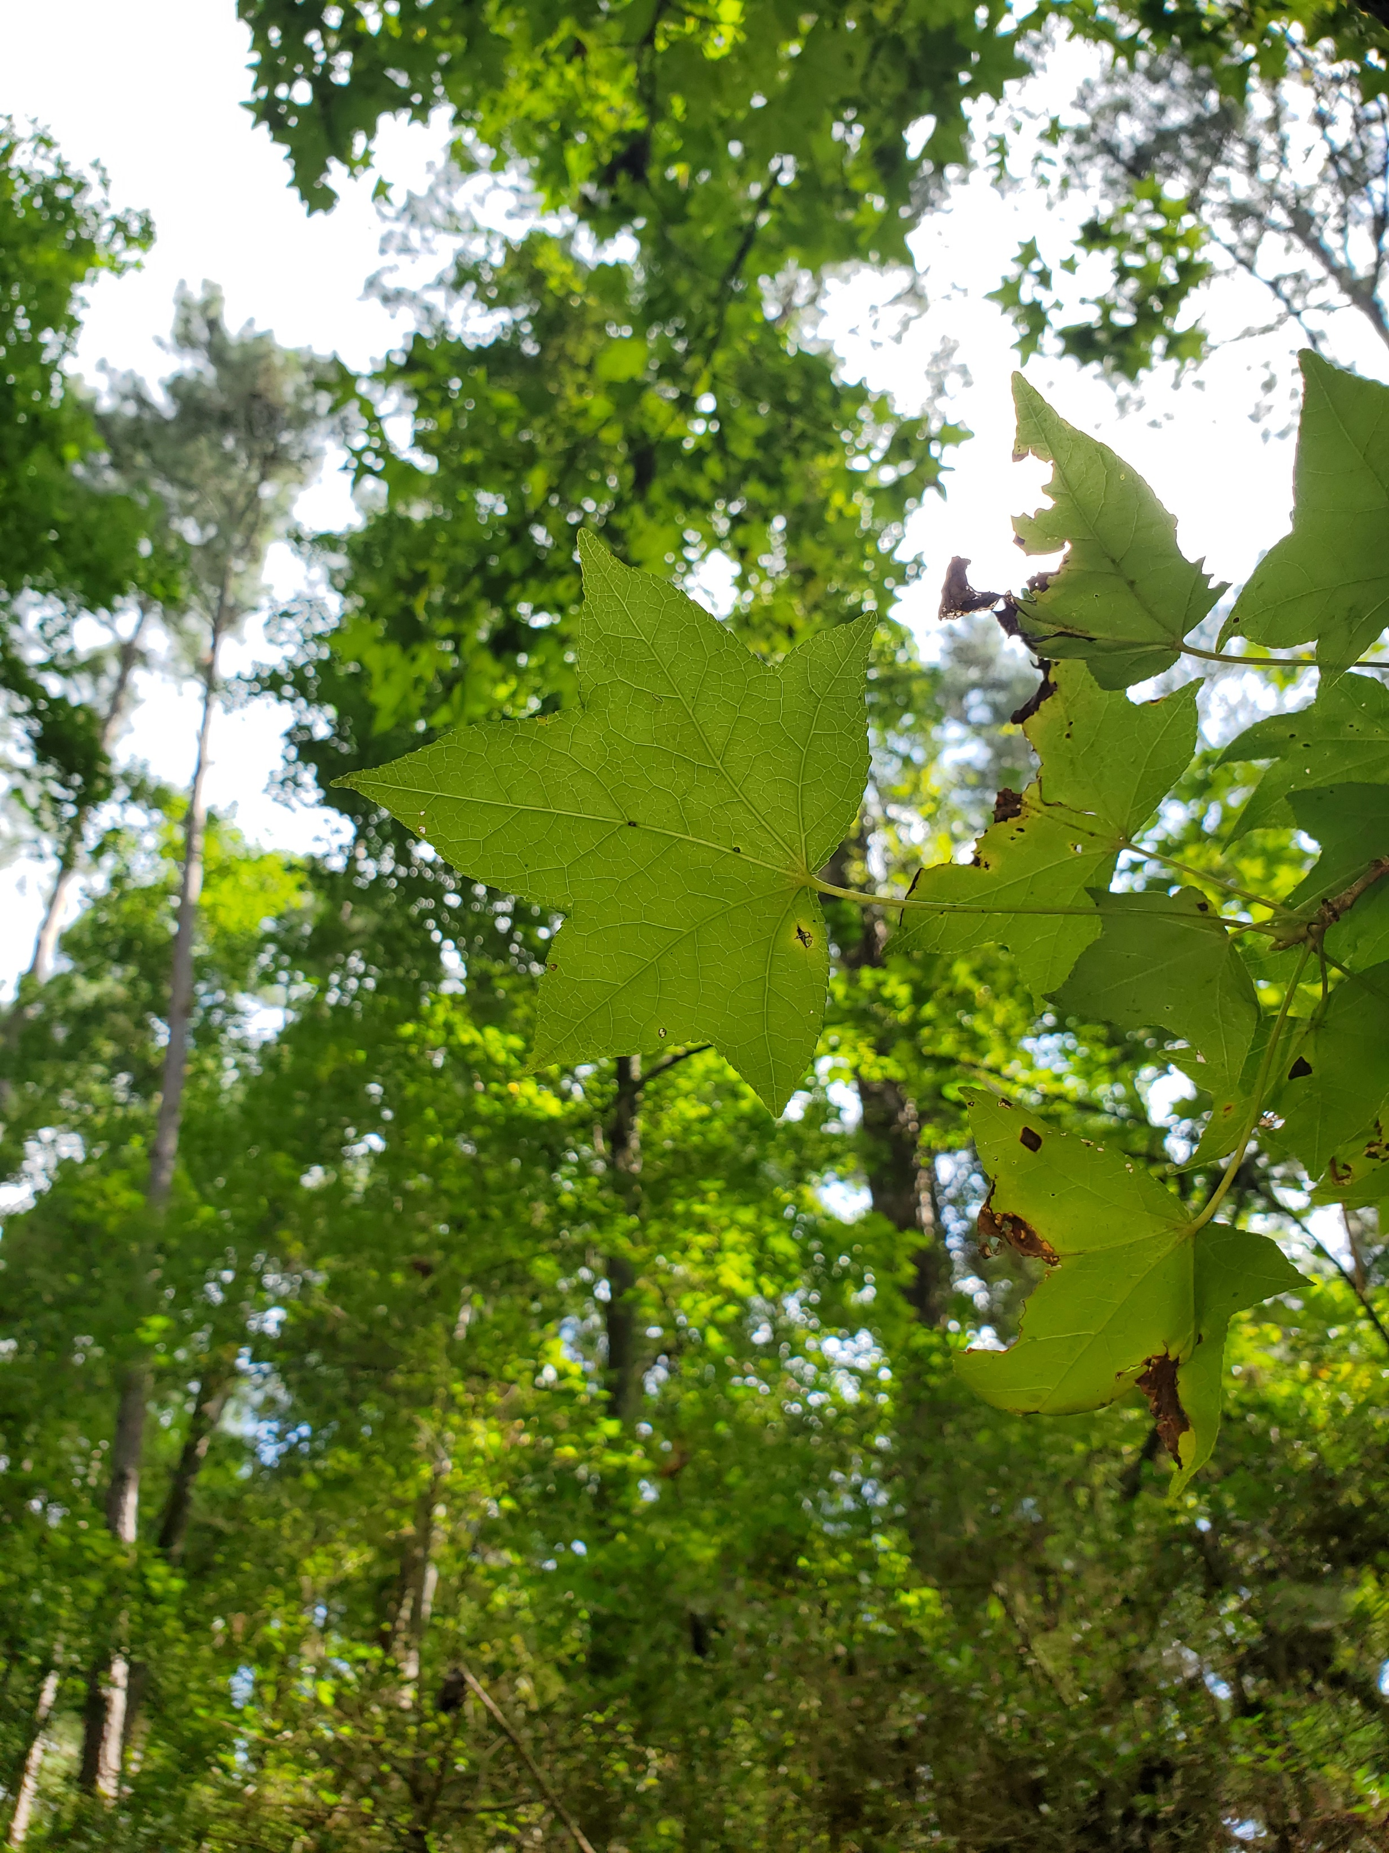
Another plant from Burroughs Park, Tomball, TX…

Slide 10
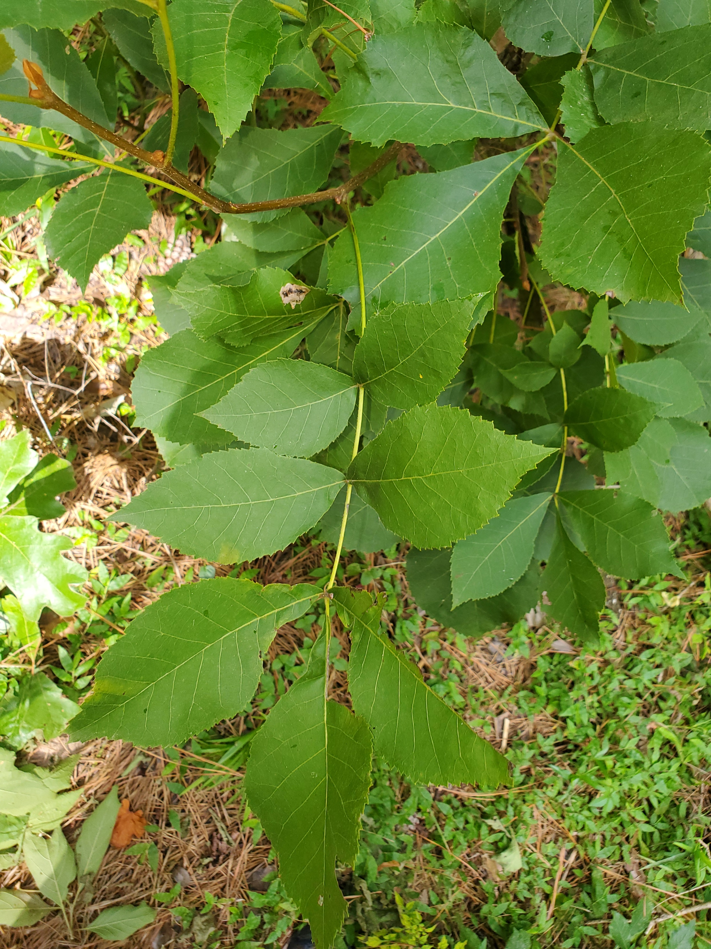

Slide 11
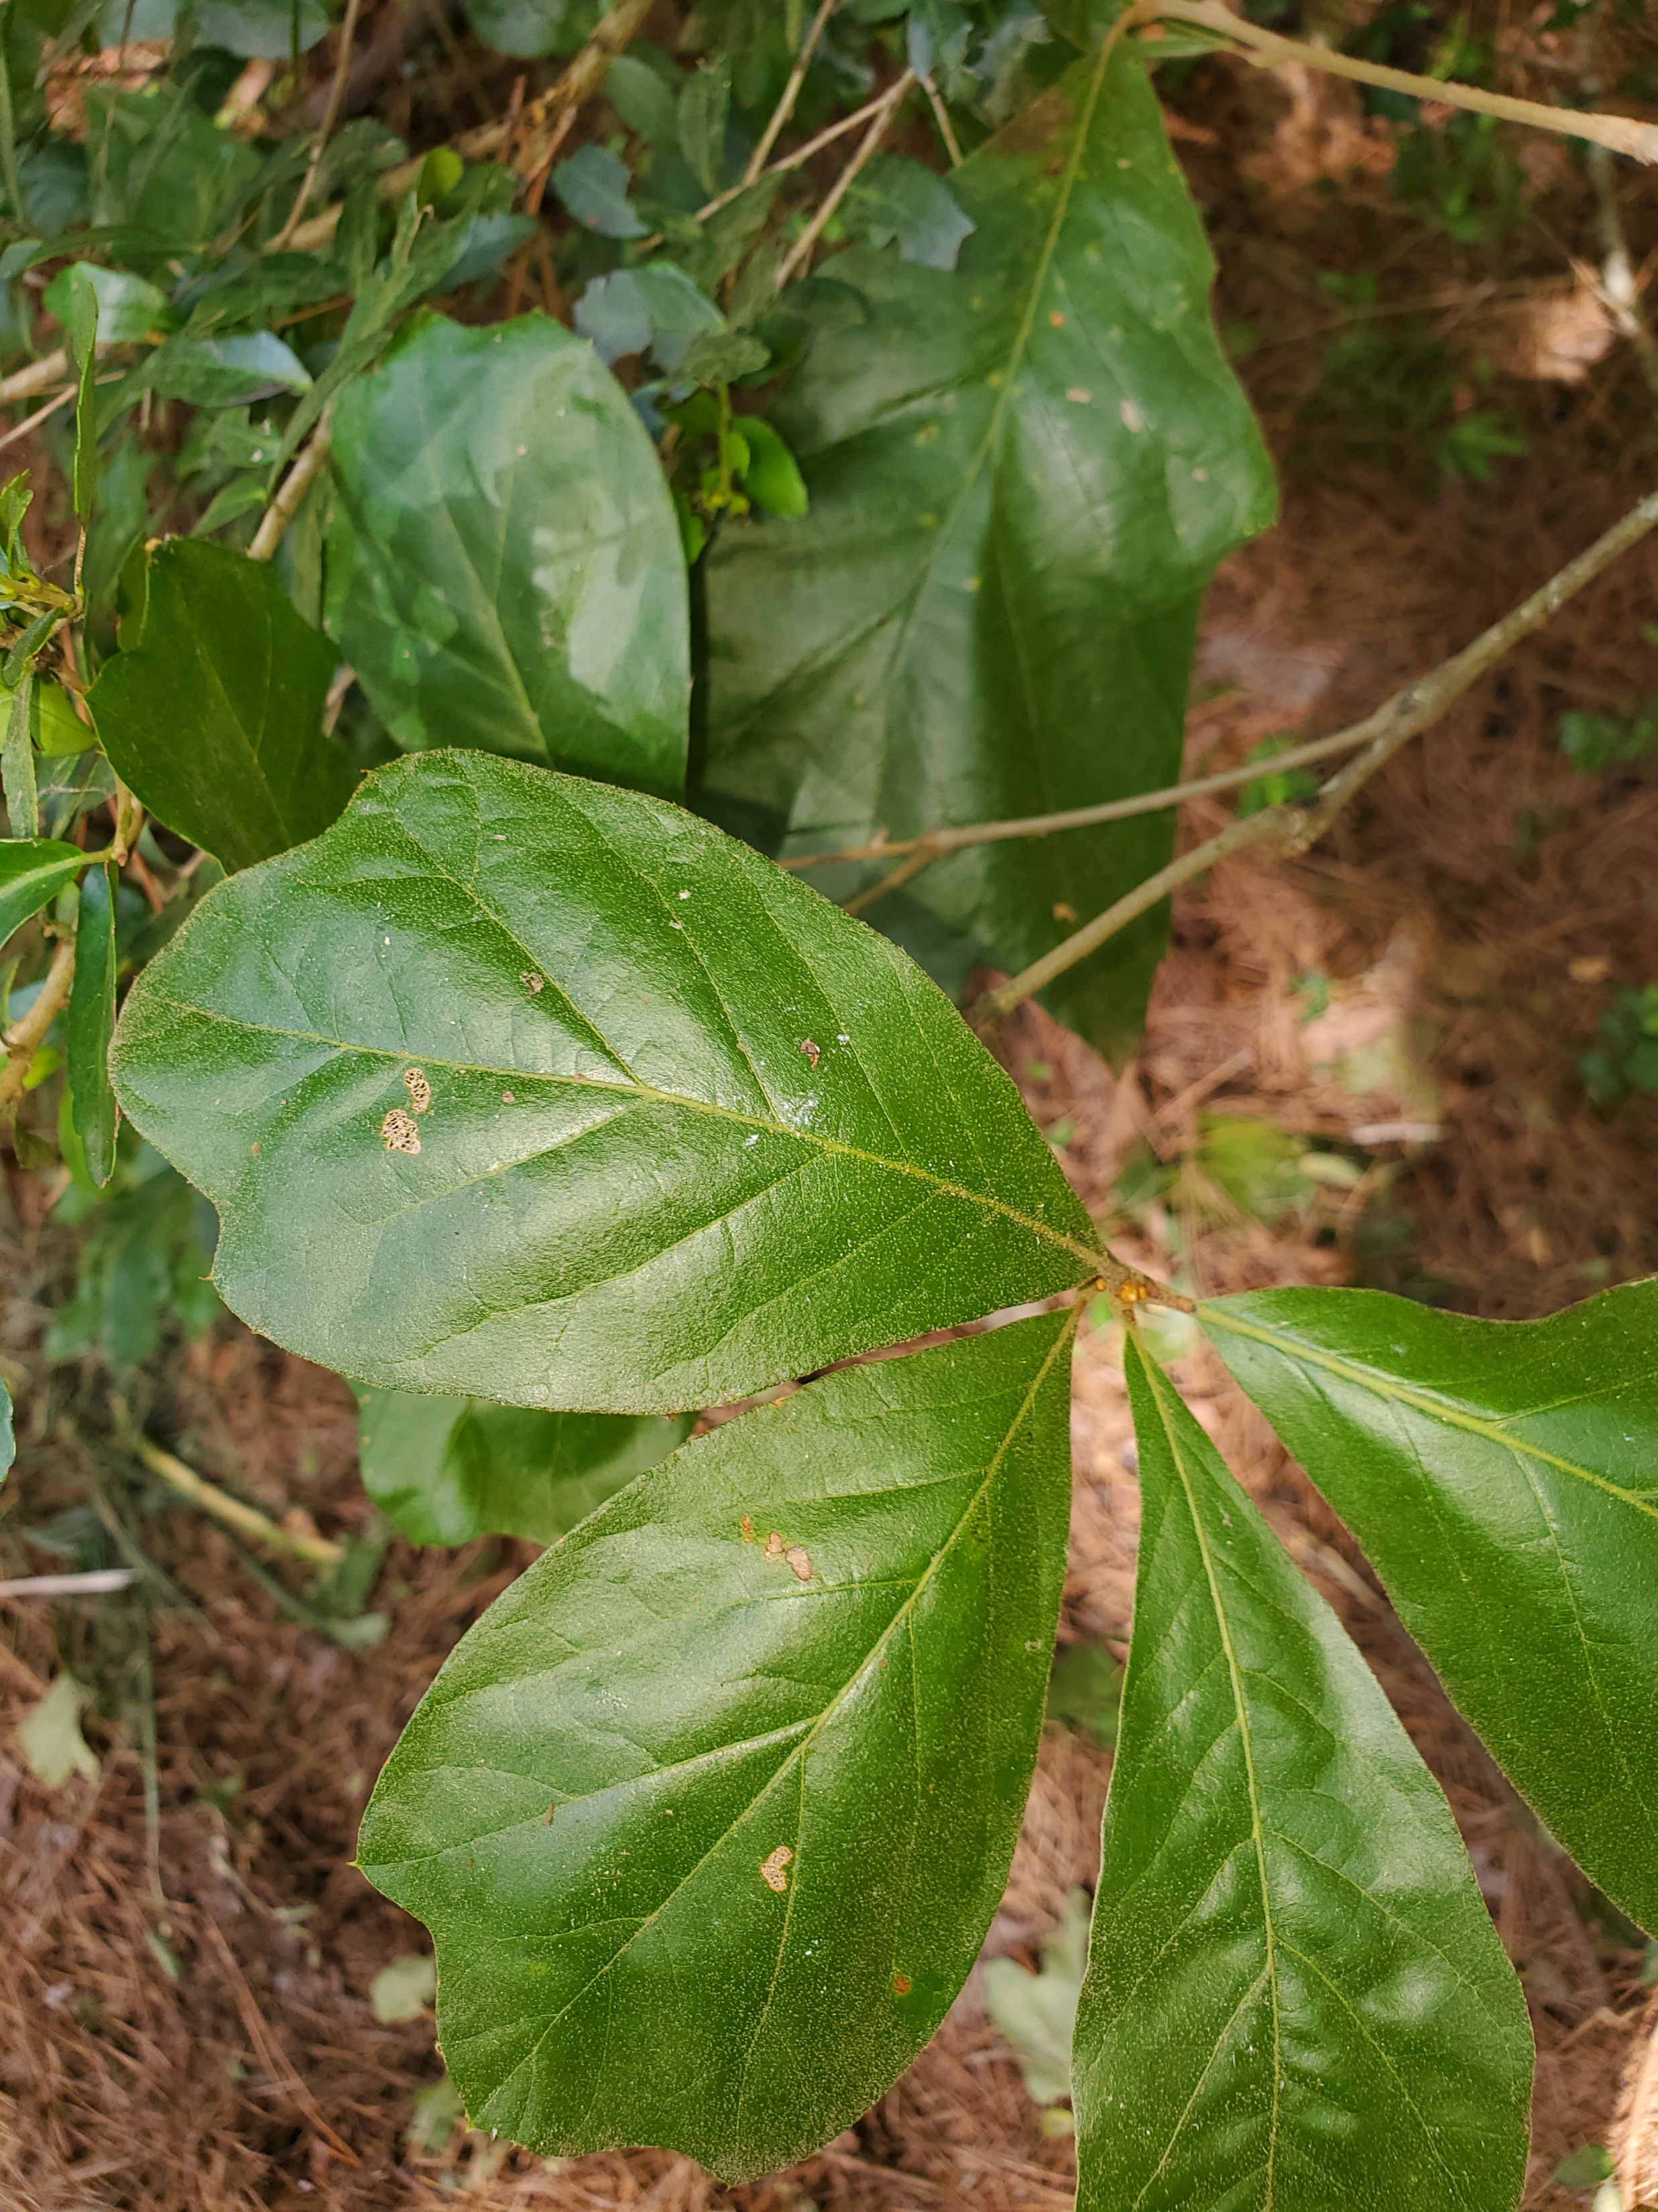

Slide 12
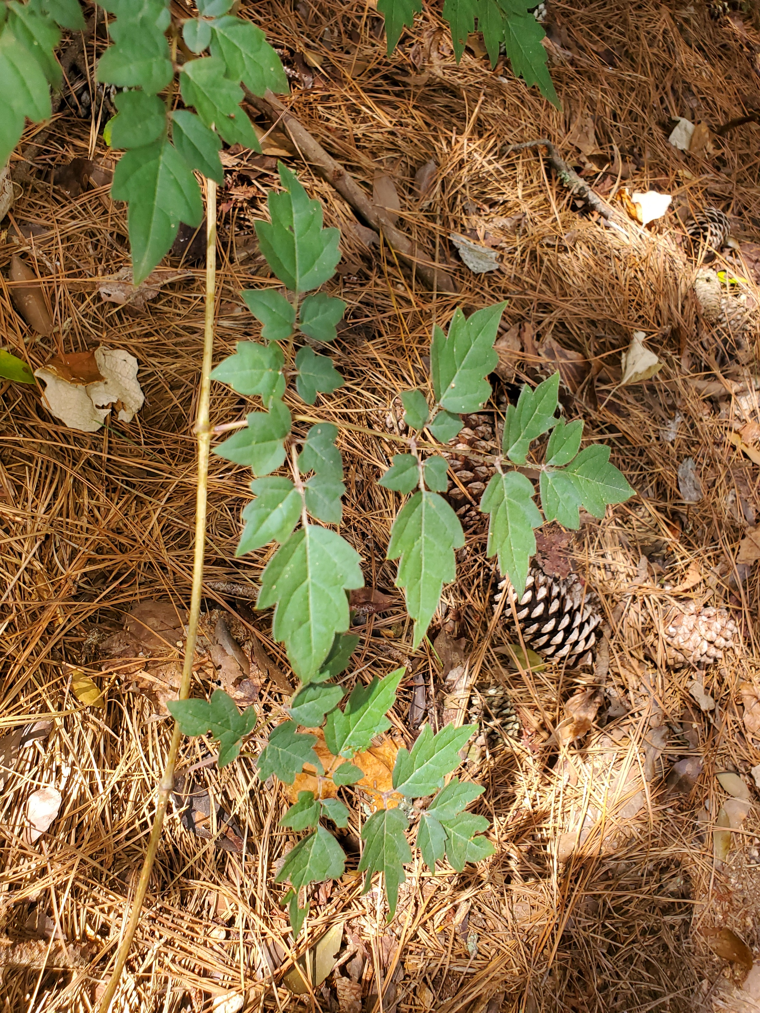

Slide 13
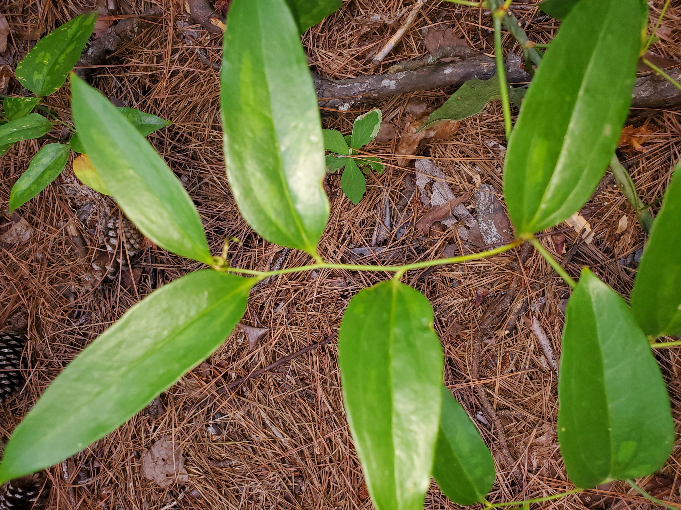

Slide 14

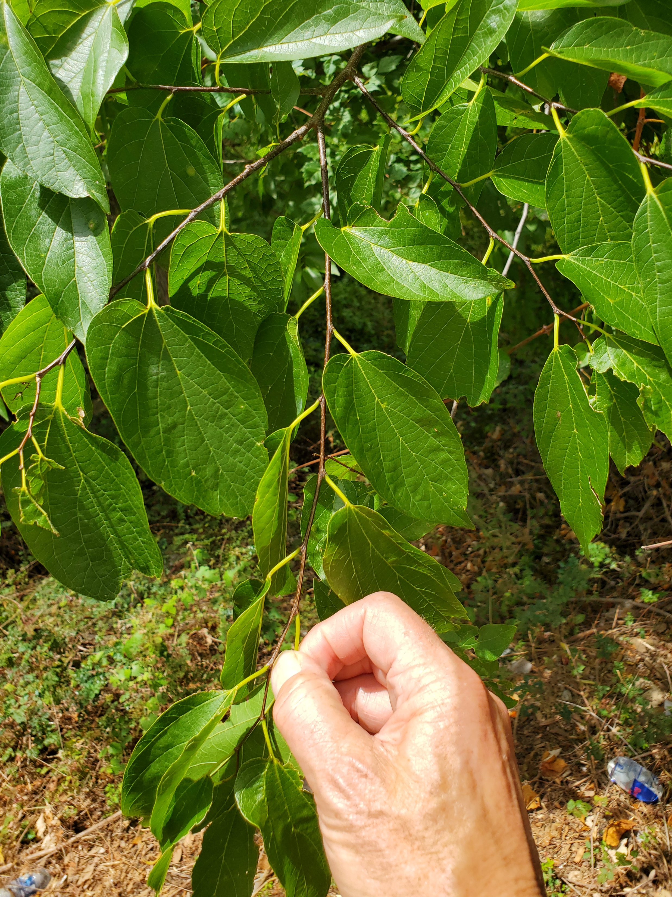

Slide 15
